Slide 1
PEP Input Class
Presented By
Kanika Sharma

Slide 2
Topics to be covered…
Operators in C++
Decision Making Statements
Simple if,
if else,
ladder if,
nested if,
goto,
switch

Slide 3
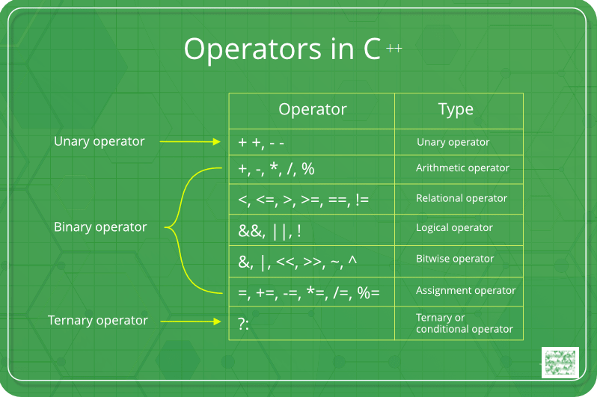

Slide 4
Bitwise operators
The & (bitwise AND) takes two numbers as operands and does AND on every bit of two numbers. The result of AND is 1 only if both bits are 1.
The | (bitwise OR) takes two numbers as operands and does OR on every bit of two numbers. The result of OR is 1 if any of the two bits is 1.
The ^ (bitwise XOR) takes two numbers as operands and does XOR on every bit of two numbers. The result of XOR is 1 if the two bits are different.
The << (left shift) takes two numbers, left shifts the bits of the first operand, the second operand decides the number of places to shift.
The >> (right shift) takes two numbers, right shifts the bits of the first operand, the second operand decides the number of places to shift.
The ~ (bitwise NOT) takes one number and inverts all bits of it.

Slide 5
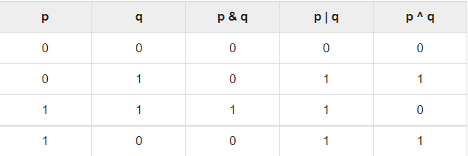
Truth table for bitwise operator

Slide 6
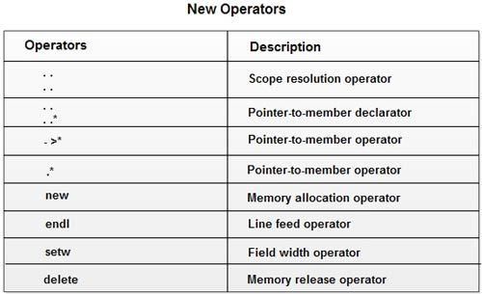
Operators in C++

Slide 7
Accessing member with pointers
class Simple
{
public:
int a;
};
int main()
{
Simple obj;
Simple* ptr; // Pointer of class type
ptr = &obj;
cout << obj.a;
cout << ptr->a; // Accessing member with pointer
}

Slide 8
Pointer to object & member
int main()
{
Data d, *dp;
dp = &d; // pointer to object
int Data::*ptr=&Data::a; // pointer to data member 'a'
d.*ptr=10;
d.print();
dp->*ptr=20;
dp->print();
}
class Data
{
public:
int a;
void print()
{
cout << "a is "<< a;
}
};

Slide 9
Pointer to member function
class Data
{
public:
int f(float)
{
return 1;
}
};
int (Data::*fp1) (float) = &Data::f; // Declaration and assignment
int (Data::*fp2) (float); // Only Declaration
int main(0
{
fp2 = &Data::f; // Assignment inside main()
}

Slide 10
Cont…
Note:
You can change the value and behaviour of these pointers on runtime. That means, you can point it to other member function or member variable.
To have pointer to data member and member functions you need to make them public.

Slide 11
Program on new operator
#include <iostream>
using namespace std;
int main () {
int *xx = new int;
int *yy = new int(12);
cout << "Value of xx pointer variable : " << *xx << endl;
cout << "Value of yy pointer variable : " << *yy << endl;
return 0;
}

Slide 12
Automata Fix Section
In this section, there will be 7 code snippets, in which there may be some error, or you may have to code a specific part of the code.
You can code in any of your desired language like C, C++ or Java. There is no restriction in coding language which you want to choose.
There is even a possibility that you can code first question in some specific language, and then you are coding the next question in some other specific language.
This test is basically for judging your interpreting level of code. This section tests, that how good you are in fixing a code written by someone else, or if you can add a small function of your own, in someone’s other code.

Slide 13
Correct the code to get desired output
Code snippet finds out the last digit of a number entered by the user.
#include <iostream>
int main()
{
int num, LD;
cout<< “Enter a number”;
cin<<num;
LD = num / 10;
cout<<" \n The Last Digit of a Given Number"<< num<< LD);
return 0;
}

Slide 14
Correct code
#include <iostream>
int main()
{
int num, LD;
cout<< “Enter a number”;
cin<<num;
LD = num % 10;
cout<<" \n The Last Digit of a Given Number"<< num<< LD);
return 0;
}

Slide 15
Correct the code to get desired output
void palindrome(int number)
{
int rev = 0,store, n1,left;
n1=number;
store= number;
while (number > 0)
{
left= number/10;
rev = rev + 10 * left;
number=number%10;
}
if(n1==rev)
cout<<"Number %d is Palindrome number“<<n1;
else
cout<<"it is not a Palindrome number";
}

Slide 16
Correct code
void palindrome(int number)
{
int rev = 0,store, n1,left;
n1=number;
store= number;
while (number > 0)
{
left= number%10;
rev = rev *10 + left;
number=number/10;
}
if(n1==rev)
cout<<"Number %d is Palindrome number“<<n1;
else
cout<<"it is not a Palindrome number";
}

Slide 17
Correct the code to get desired output
#include <iostream>
using namespace std;
int main()
{
cout<<"Welcome to \"LPU";
return 0;
}
Desired Output:
Welcome to “LPU”

Slide 18
Correct code
#include <iostream>
using namespace std;
int main()
{
cout<<"Welcome to \"LPU\"";
return 0;
}

Slide 19
Practice questions
Given a positive integer , do the following:
print the lowercase English word corresponding to the number (e.g., one for , two for , etc.).
print Greater than 9.
Use ladder if

Slide 20
Debugging the code

Slide 21
Problem 1
#include<iostream.h>
void main()
{
short i=2500, j=3000;
cout>> "i+j=">> -(i+j);
}

Slide 22
Answer
cout >> “i+j=”>> -(i + j); -> Illegal structure operation.

Slide 23
Problem 2: Complete the code
To check if two numbers are equal without using arithmetic operators or comparison operators.
#include <iostream>
using namespace std;
int main()
{
int x = 10;
int y = 10;
????????????
cout << " x is equal to y ";
else
cout << " x is not equal to y ";
return 0;
}

Slide 24
Solution
#include <iostream>
using namespace std;
int main()
{
int x = 10;
int y = 10;
if (!(x ^ y))
cout << " x is equal to y ";
else
cout << " x is not equal to y ";
return 0;
}

Slide 25
Predict the output
#include <stdio.h>
void main()
{
cout<<"value is ,(10++));
}

Slide 26
Solution
Error: L value required

Slide 27
Predict the output
#include <iostream>
using namespace std;
int main()
{
unsigned short var='B';
var+=2;
var++;
cout<<var<<char(var);
}

Slide 28
Solution
69 E

Slide 29
Predict the output
#include <iostream>
using namespace std;
int main()
{
int x=(20 || 40 ) && (10);
cout<<x;
}

Slide 30
Solution
X=1

Slide 31
Hands on exercise
Coding

Slide 32
Problem Statement
Ritik wants a magic board, which displays a character for a corresponding number for his science project. Help him to develop such an application. For example when the digits 65,66,67,68 are entered, the alphabet ABCD are to be displayed. [Assume the number of inputs should be always 4 ]

Slide 33
Solution
#include <iostream>
using namespace std;
int main()
{
int a,b,c,d;
cout<<"Enter the digits:";
cin>>a>>b>>c>>d;
char q=(char)a;
char w=(char)b;
char e=(char)c;
char r=(char)d;
cout<<q<<w<<e<<r;
return 0;
}

Slide 34
Problem statement 2
Chaman planned to choose a four digit lucky number for his car. His lucky numbers are 3,5 and 7. Help him find the number, whose sum is divisible by 3 or 5 or 7. Provide a valid car number, Fails to provide a valid input then display that number is not a valid car number.
Note : The input other than 4 digit positive number[includes negative and 0] is considered as invalid.

Slide 35
Solution
else
{
int sum = 0;
while (n > 0)
{
sum += n % 10;
n /= 10;
}
if (sum % 3 == 0 or sum % 5 == 0 or sum % 7 == 0)
cout << "Lucky Number";
else
cout << "Sorry its not my lucky number";
}
return 0;
}
#include<bits/stdc++.h>
using namespace std;
int main ()
{
int n;
cin >> n;
int digit = floor (log10 (n) + 1);
if (n <= 0 or ! (digit == 4))
cout << n << " is not a valid car number";

Slide 36
Problem Statement 3
Write a program to calculate the fuel consumption of your truck.The program should ask the user to enter the quantity of diesel to fill up the tank and the distance covered till the tank goes dry.Calculate the fuel consumption and display it in the format (liters per 100 kilometers).
Convert the same result to the U.S. style of miles per gallon and display the result. If the quantity or distance is zero or negative display ” is an Invalid Input”.
[Note: The US approach of fuel consumption calculation (distance / fuel) is the inverse of the European approach (fuel / distance ). Also note that 1 kilometer is 0.6214 miles, and 1 liter is 0.2642 gallons.]

Slide 37
Thanks.

